Slide 1
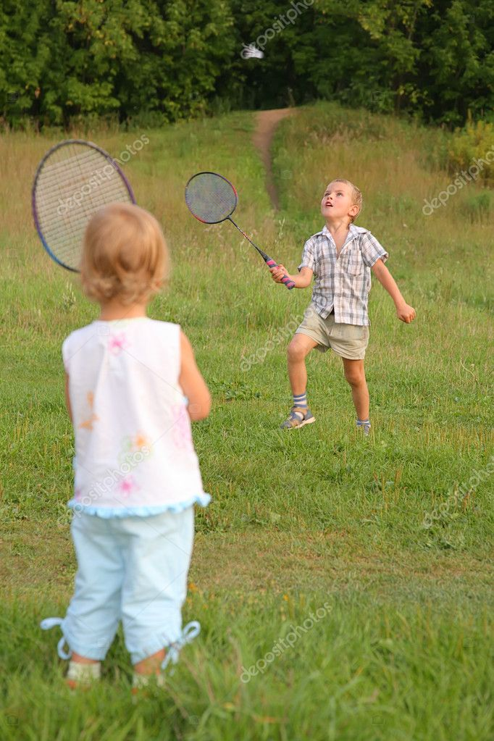
Capstone Project
Life Sports Total Solution
Team 11
Geum Kang Hyeon
Kong Chan Hyung
Lee Dong Hyun

Slide 2
Contents
01 Feedback
02 Setting Development Range
03 UI Design
04 Construct Development Environment
05 Data Collection
06 Development Plan

Slide 3
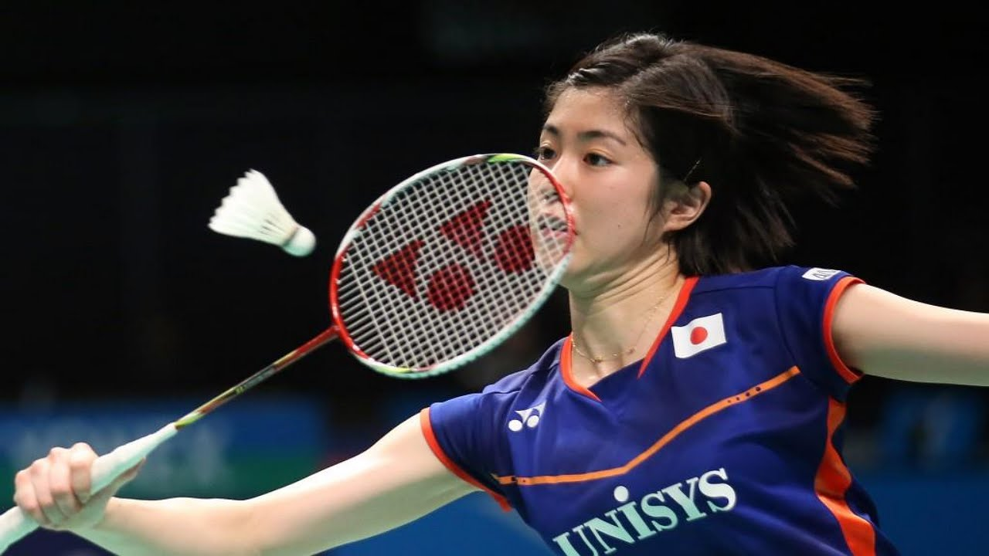
PART 1
Feedback

Slide 4
001
Feedback
Can you play with similar skilled player?
Player’s Personal Information
Results of a game
Mutual Evaluation
Analysis
Measure player’s skill

Slide 5
PART 2
Setting
Development Range

Slide 6


002
Setting Development Range
User
Manager
Player

Slide 7


002
Setting Development Range
Function
Facility Management
Schedule Management
Reservation Management
Reservation
Matching
Ranking
Team Management
My Page
+
Etc..
Login / Register
Score Analysis & Ranking Algorithm

Slide 8
002
Setting Development Range
Development
Web for Manager
App for Player

Slide 9
PART 3
UI Design

Slide 10
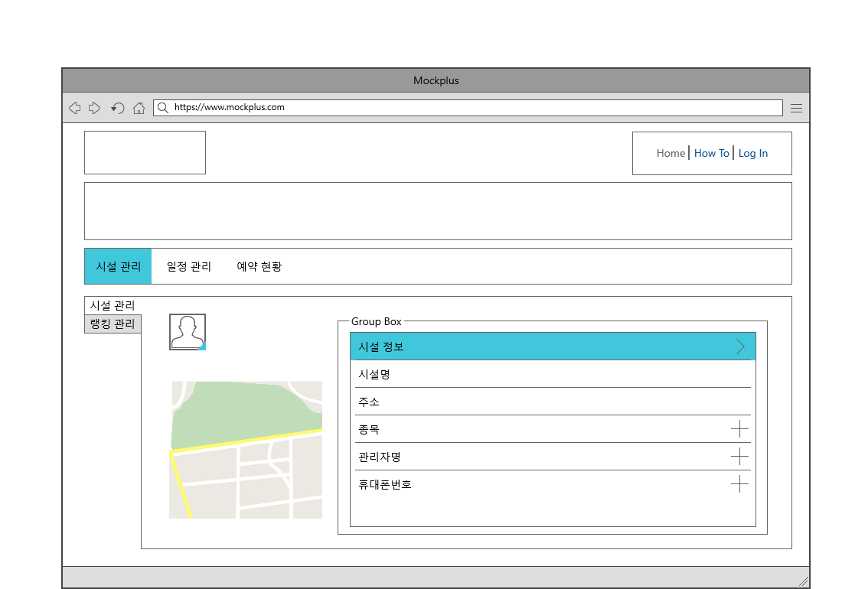
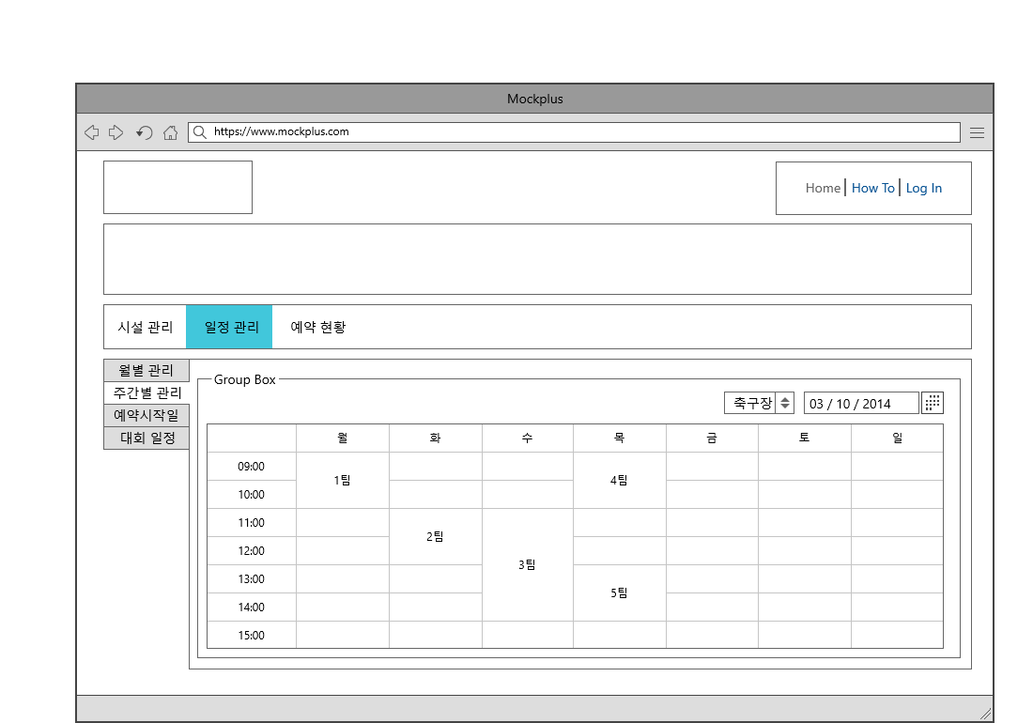
003
UI Design
Web UI Design

Slide 11
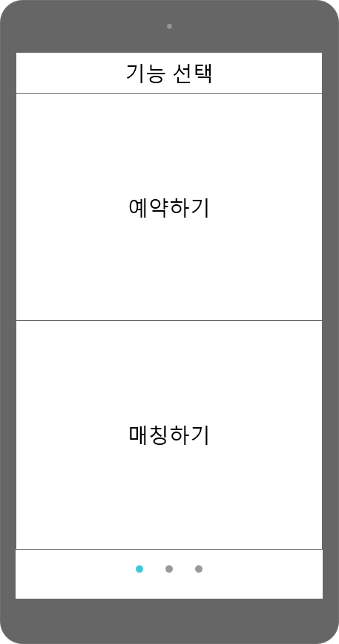
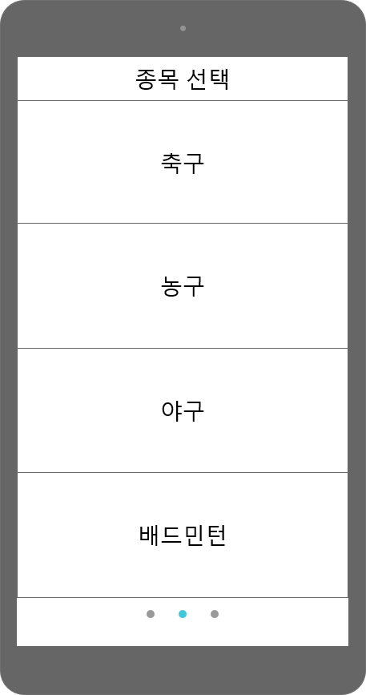
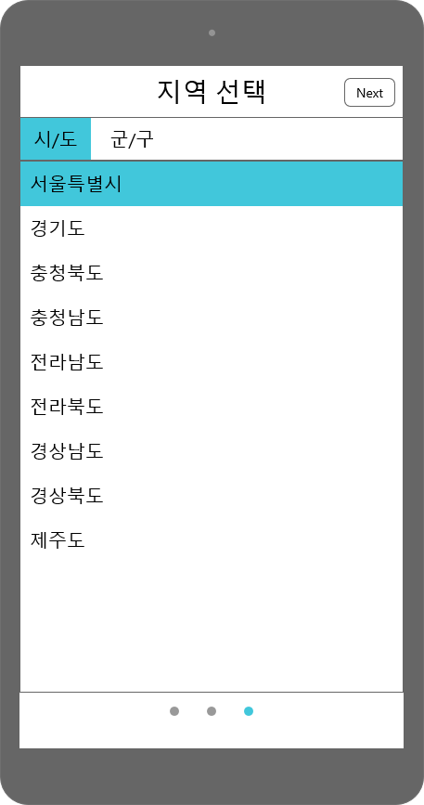
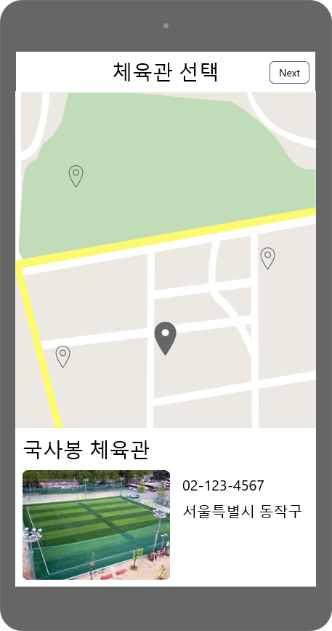
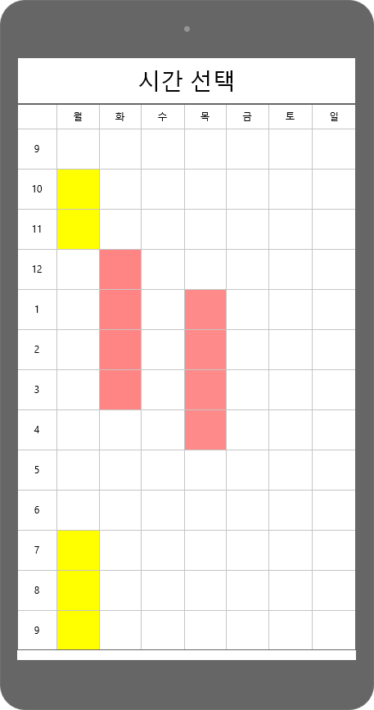
003
UI Design
App UI Design

Slide 12
Environment
Setting
PART 4

Slide 13

004
Environment Setting
Server
Web
App
AWS EC2
CentOS 7
Tomcat 7.0
MariaDB
Spring
JSP
React Native

Slide 14
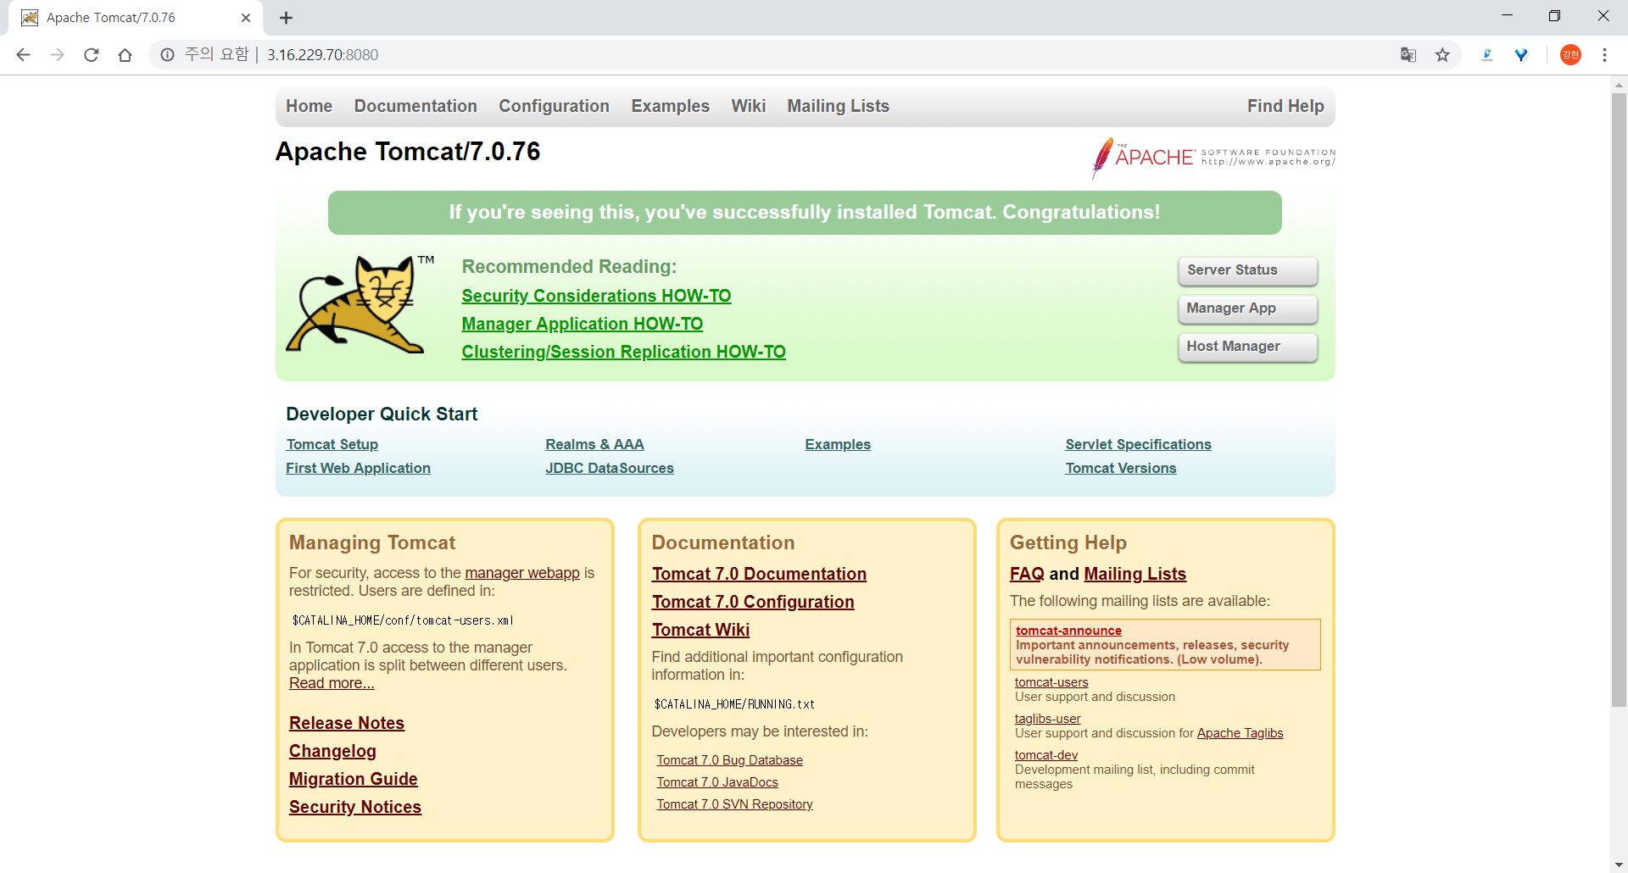
004
Environment Setting
Server

Slide 15
004
Environment Setting
Spring Framework
Install Spring Framework in Eclipse
Connect Tomcat and Spring

Slide 16
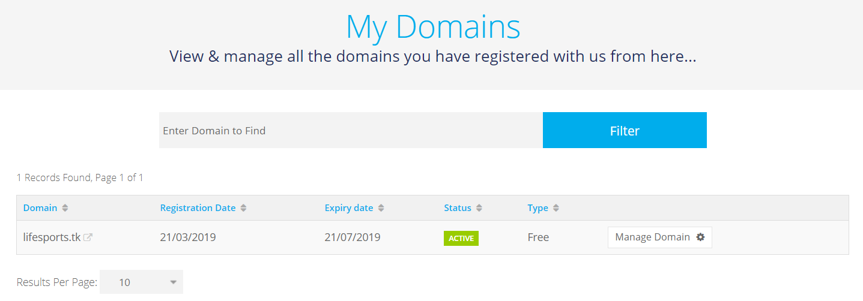

004
Environment Setting
Domain
DNS는 freenom에서 무료 도메인 구매 완료
IP 연결은 AWS Route 53 사용

Slide 17
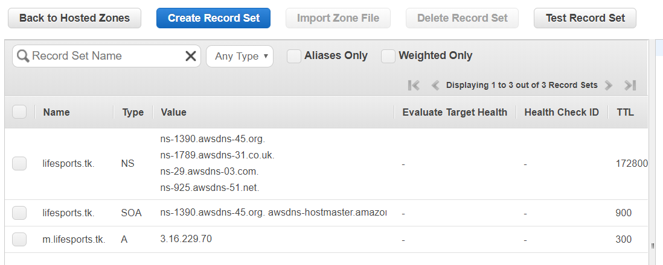

004
Environment Setting
Connection

Slide 18
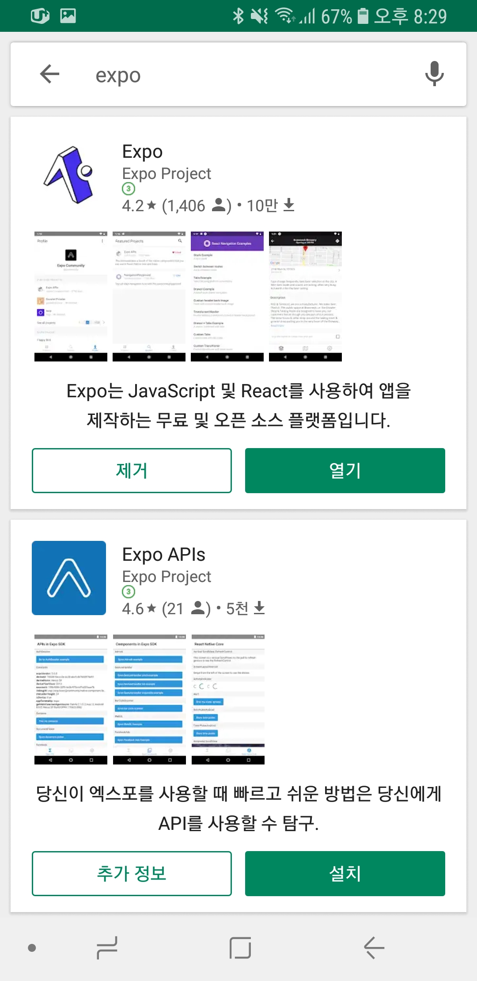
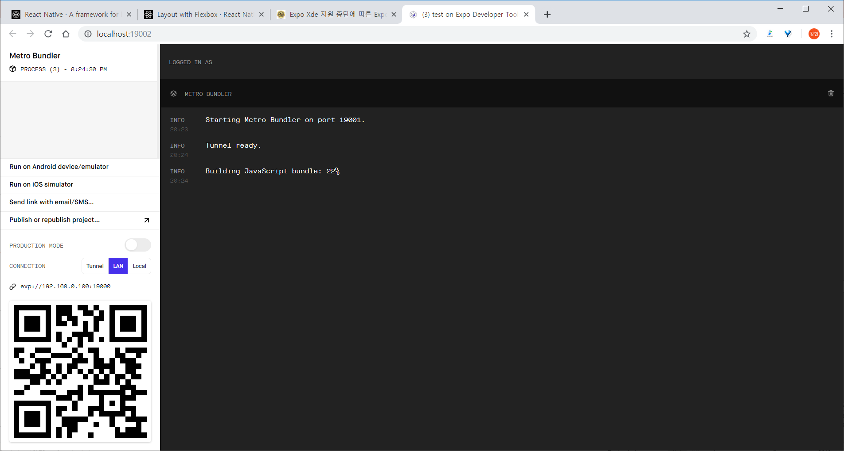
004
Environment Setting
App Environment – React Native

Slide 19
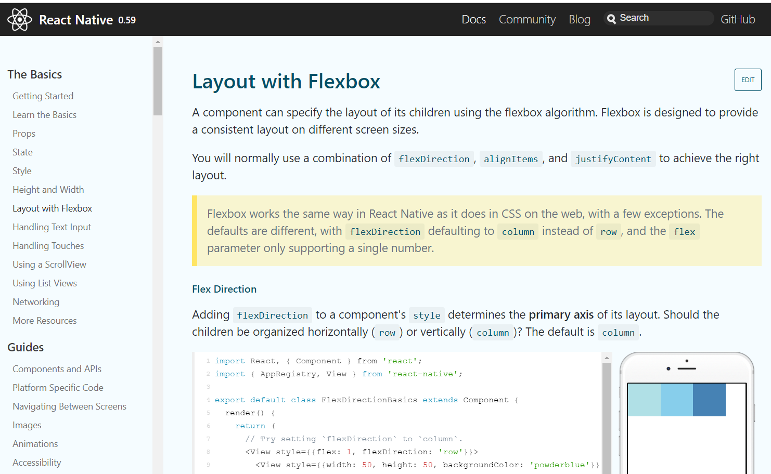
004
Environment Setting
App Environment – React Native
Study with tutorials
Implement Reservation
From this week

Slide 20
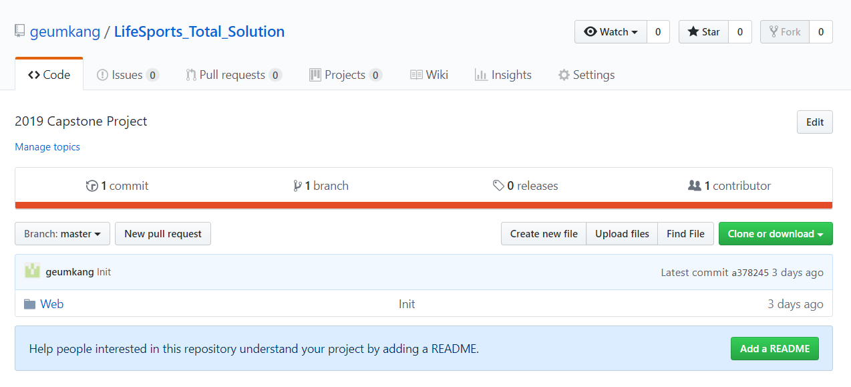
004
Environment Setting
Github

Slide 21
PART 5
Data Collection

Slide 22
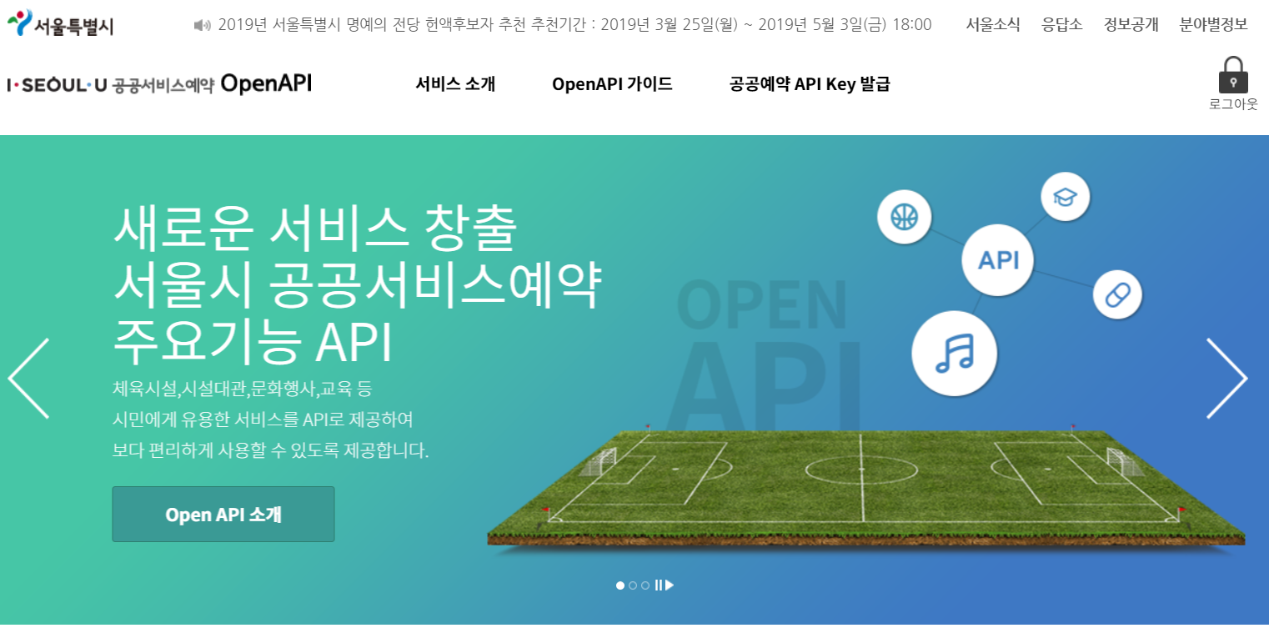
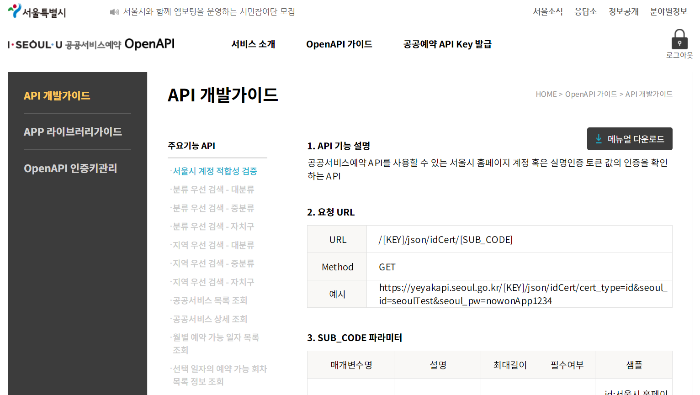
005
Data Collection
Try to Use

Slide 23
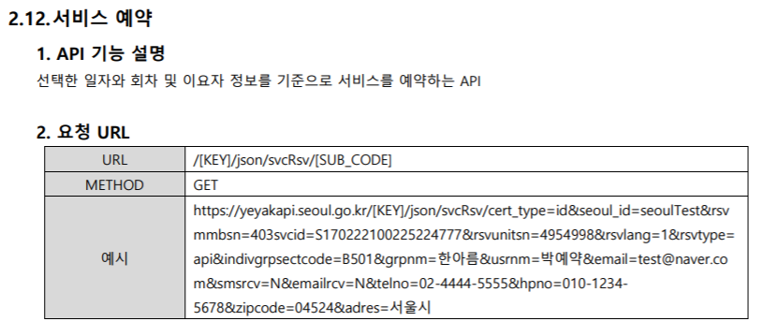
005
Data Collection
Problem
Manual is Poor
1. ‘svcid’ list is not exist
2. Address is road name
“ADRES”:“서울 송파구 올림픽로25”

Slide 24
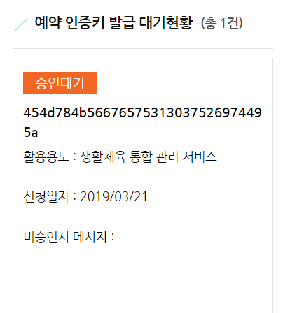
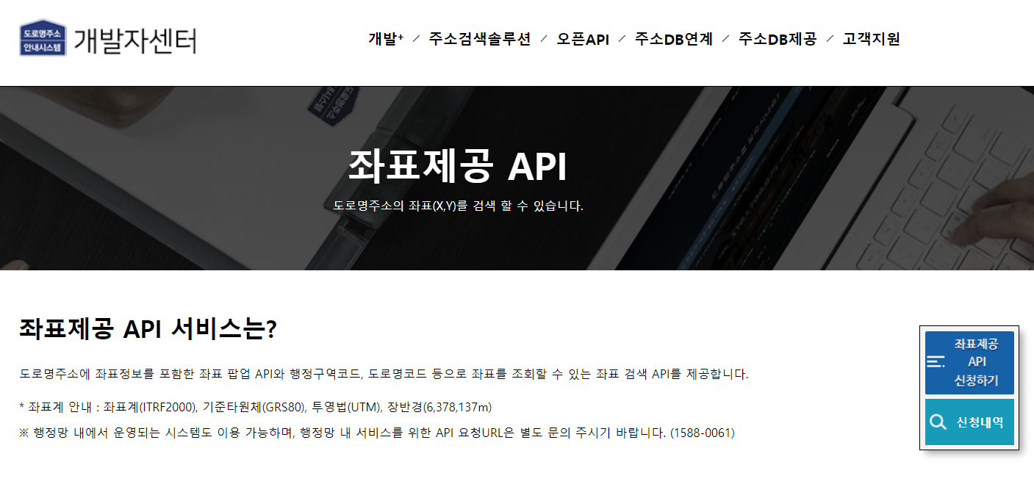
005
Data Collection
Waiting for the certificate key to be approved

Slide 25
Development
Plan
PART 6

Slide 26
005
Development Plan
4th Week
Dates Task Descriptions | March |  |  |  | April |  |  |  |  | May |  |  |  | June
 | 4 | 11 | 18 | 25 | 1 | 8 | 15 | 22 | 29 | 6 | 13 | 20 | 27 | 3 | 10 | 17
Team Organization |  |  |  |  |  |  | Midterm Demonstration & Presentation |  |  |  |  |  |  | Final Demonstration & Presentation
Subject Confirmation / Write out the Proposal
Web UI Design
Web Structure Construction
Data collection & Generation / Data modeling
Database Construction
App UI Design
App Structure Construction
Functional Implementation : Manager Web Site
Functional Implementation : Reservation (App)
Hadoop Installation / CDH Cluster Construction
Data Analysis using Hadoop Cluster
Functional Implementation : Matching Service (App)
Functional Implementation : Ranking System (App)
Test and Debugging
Preparing for Final Demo
Writing Manuals and Reports

Slide 27
Thank You!

Slide 28
001
Planning Intent
Template

